Slide 1
Transport Layer Protocols II
Course Code: COE 3206
Course Title: Computer Networks
Dept. of Computer Science
Faculty of Science and Technology
Lecturer No: | 14 | Week No: | 15 | Semester: | Summer 23-24
Lecturer: | Md. Faruk Abdullah Al Sohan; faruk.sohan@aiub.edu

Slide 2
Lecture Outline
Congestion in networks
Congestion control
TCP Reno
Error control principle
Sliding window technique

Slide 3
Congestion in networks
Congestion
Congestion is a situation in a network in which the load on the network, the number of packets sent to the network, is greater than the capacity of the network, the number of packets a network can handle.
Congestion control
Congestion control refers to the mechanisms and techniques to control the congestion and keep the load below the capacity [1].

Slide 4
Congestion in networks…
Congestion in a network or internetwork occurs because routers and switches have queues-buffers that hold the packets before and after processing.
A router, for example, has an input queue and an output queue for each interface.
When a packet arrives at the incoming interface, it undergoes three steps before departing:
The packet is put at the end of the input queue while waiting to be checked.
The processing module of the router removes the packet from the input queue once it reaches the front of the queue and uses its routing table and the destination address to find the route.
The packet is put in the appropriate output queue and waits its turn to be sent.

Slide 5
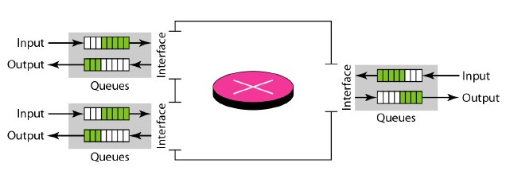
Congestion in networks…
Two possible scenarios in a router:
Packet arrival rate > packet processing rate,
the input queues become longer and longer.
2. Packet departure rate < Packet processing rate,
the output queues become longer and longer

Slide 6
Congestion Control
Terminology
Congestion Window
The number of bytes the sender may have in the network at any time [2]
LastByteSent – LastByteAcked <= cwnd
Sending Rate
The congestion window size divided by the round-trip time (RTT¹) of the connection [2].
By adjusting the value of cwnd, the sender can therefore adjust the rate at which it sends data into its connection [3].
1 The time from when a segment is sent until it is acknowledged.

Slide 7
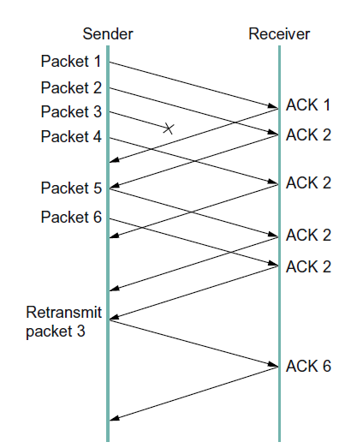
Congestion Control
Terminology
Loss Event
Timeout
Sender does not receive any acknowledgement within a predefined interval
3 duplicate Acknowledgement (3 duplicate ACK)
Reception of the same ACK four times.
Indicates that the channel is not congested that much
as the receiver is still receiving segments.
Indicates that the segment 3 is lost as it receives the duplicate
ACK 3
Receiver is receiving segment out of order.
ACK 2
ACK 3
ACK 3
ACK 3
ACK 3
ACK 7

Slide 8
Congestion Control
TCP Reno
Steps of congestion window control
Slow Start
Congestion Avoidance

Slide 9
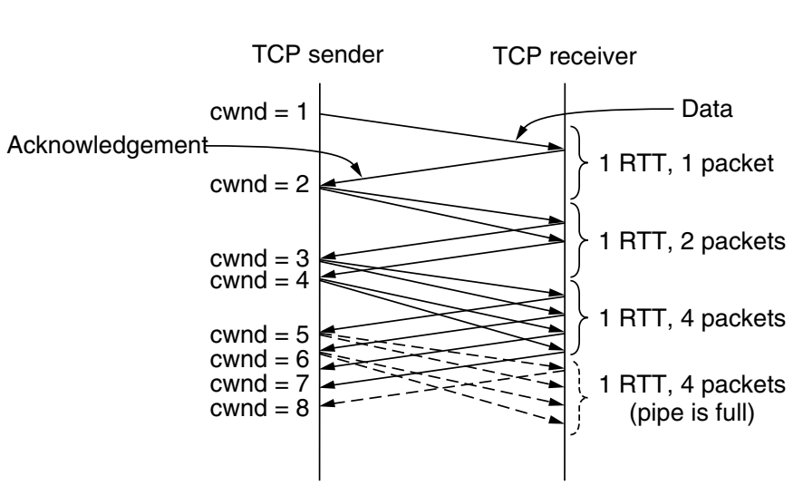
Congestion Control
TCP Reno
Slow Start
Follows a greedy approach.
Starts sending data of size equals maximum sized segment (MSS).
If it receives an ACK for the previous transmission by next RTT → it sends 2 MSS.
After next RTT, if it receives two ACKs → it sends 2+2=4 MSS in next round.
Fig. 1 Slow start from an initial congestion
window of one segment [2].

Slide 10
Congestion Control
TCP Reno
Slow Start (cont.)
That is, in each round, N+M MSS in a round if it sends N MSS in the last transmission round and receives M ACK before the current round.
If it receives ACK for all the N MSS (previously sent), it sends N+N MSS this round.
Fig. 1. Slow start from an initial congestion
window of one segment [2].

Slide 11
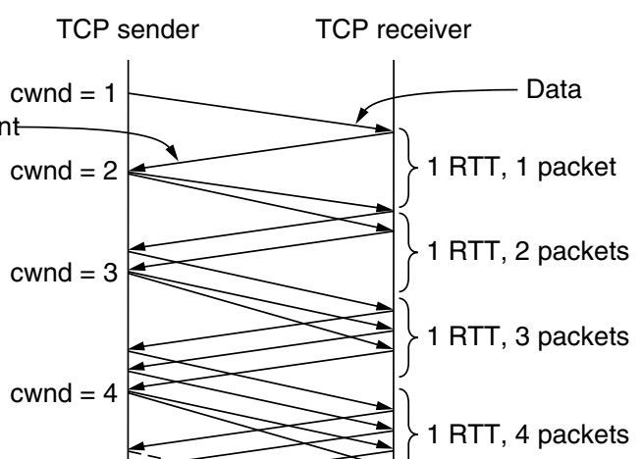

Congestion Control
TCP Reno
Congestion Avoidance
How long does cwnd continue to be increased exponentially?
$$if cwnd≥threshold$$
Increase cwnd by1 per transmission round
That is, increase cwnd linearly¹
Fig. 2. Linear increase of cwnd
1. Usually timeout and 3 duplicate ACK do not happen in slow start

Slide 12
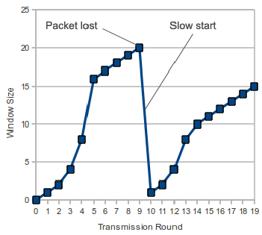


Congestion Control
TCP Reno
How long does cwnd continue to be increased linearly?
Timeout
Until one of two incidents happen
Timeout
3 duplicate ACK
Threshold
Timeout
$$Threshold=\frac{cwnd}{2}$$
$$cwnd=1 MSS$$
Fig. 3. Timeout
Start slow start

Slide 13
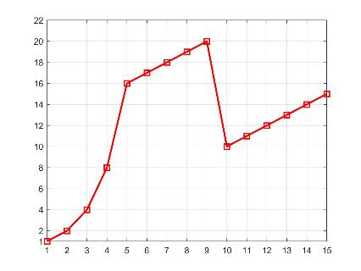


Congestion Control
TCP Reno
3 duplicate ACK
3-duplicate ACK
$$Threshold=\frac{cwnd}{2}$$
ssth
$cwnd=$ $Threshold$
cwnd
ssth
Start congestion avoidance
RTT
Fig. 4. 3 duplicate ACK

Slide 14
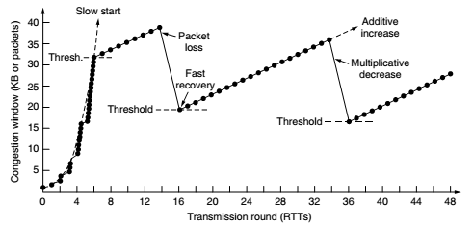
Congestion Control
TCP Reno
Fig. 5. TCP reno example

Slide 15
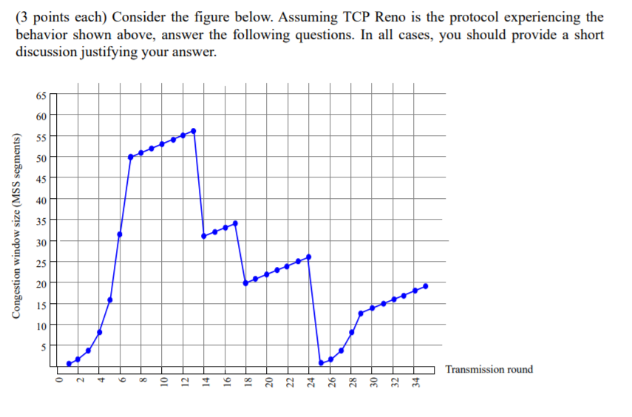
Find the Events in the TCP RENO. What are The Values Of Ssthresh And Cwnd at Each Event.

Slide 16
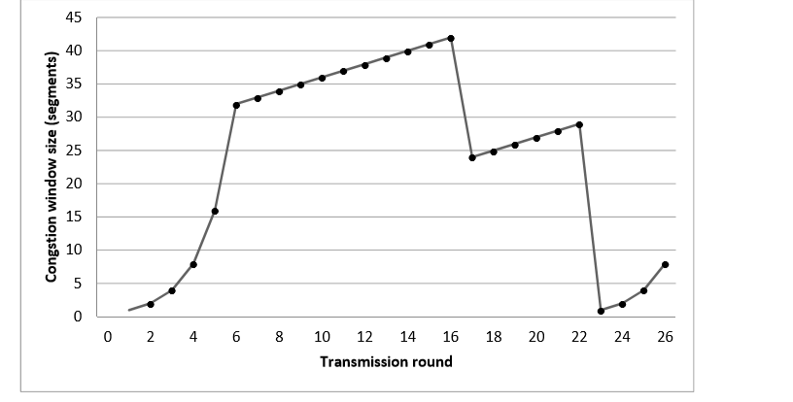
Task 2
Identify Timeout/3 duplicate ACK incidence. Also identify slow start, congestion avoidance period.

Slide 17
Flow control
The TCP stores the data that needs to be sent in the send buffer and the data to be received in the receive buffer. Flow control makes sure that no more packets are sent by the sender once the receiver’s buffer is full as the messages will be dropped and the receiver won’t be able to handle them. In order to control the amount of data sent by the TCP, the receiver will create a buffer which is also known as Receive Window.

Slide 18
Flow control
Send window
Sequence of byte numbers of which some are sent but yet to be acknowledged
while others are waiting to be sent
Maintained by sender
Receive window
Sequence of byte numbers which are expected to be received
Maintained by receiver

Slide 19
References
[1] B. A. Forouzan, Data Communication and Networking, 4th ed., Tata McGraw Hill Companies, Inc., New Delhi, 2010, pp. 385.
[2] A. S. Tanenbaum and D. J. Wetherall, Computer Networks, 5th ed., Pearson
Education India, 2013, pp. 571-572.
[3] J. F., Kurose and K. W. Ross, Computer Networking: A Top-Down Approach, 7th ed.,
Pearson Education, Inc., USA, 2017, pp. 274-277.
[4] D. Medhi and K. Ramassamy, Network Routing Algorithms, Protocols and
Archtectures, 2nd ed., Elsevier Inc., 2018, pp. 607-608.
[5] D. Runemalm , D. M. Sarwar and M. Shalbaf, “Decreasing the Hybrid-ARQ bandwidth
overhead through the Multiple Packet NAK (MPN) protocol”,
https://www.researchgate.net/publication/267554658 , [Accessed: April. 22, 2020].
[6] B. A. Forouzan, TCP/IP Protocol Suite, 4th ed., McGraw Hill Companies, Inc., USA,
2010, pp. 457-462.

Slide 20
Recommended Books
Data Communications and Networking, B. A. Forouzan, McGraw-Hill, Inc., Fourth Edition, 2007, USA.
Computer Networking: A Top-Down Approach, J. F., Kurose, K. W. Ross, Pearson Education, Inc., Sixth Edition, USA.
Official Cert Guide CCNA 200-301 , vol. 1, W. Odom, Cisco Press, First Edition, 2019, USA.
CCNA Routing and Switching, T. Lammle, John Wily & Sons, Second Edition, 2016, USA.
TCP/IP Protocol Suite, B. A. Forouzan, McGraw-Hill, Inc., Fourth Edition, 2009, USA.
Data and Computer Communication, W. Stallings, Pearson Education, Inc., Tenth Education, 2013, USA.

